Slide 1

Algebra 1
Unit 9, Lesson 4 Writing a Quadratic Function From a Written Description Volume 2, pg. 77

Slide 2


Benchmarks
MA.912.AR.1.2
Rearrange equations or formulas to isolate a quantity of interest.
MA.912.AR.3.4
Write a quadratic function to represent the relationship between two quantities from a graph, a written description, or a table of values within a mathematical or real-world context.
volume 2, pg. 77

Slide 3
Integrated Mathematical Thinking and Reasoning Standards
MA.K12.MTR.1.1 Actively participate in effortful learning both individually and collectively.
MA.K12.MTR.2.1 Demonstrate understanding by representing problems in multiple ways.
MA.K12.MTR.3.1 Complete tasks with mathematical fluency.
MA.K12.MTR.4.1 Engage in discussions that reflect on the mathematical thinking of self and others.
MA.K12.MTR.5.1 Use patterns and structure to help understand and connect mathematical concepts.
MA.K12.MTR.7.1 Apply mathematics to real-world contexts.
volume 2, pg. 77

Slide 4

Learning Targets
I can write a quadratic function to represent the relationship between two quantities from a written description.
I can rewrite a quadratic equation from vertex form to standard form.
I can solve for a variable of interest.
volume 2, pg. 77

Slide 5

Warm-Up
volume 2, pg. 77

Slide 6
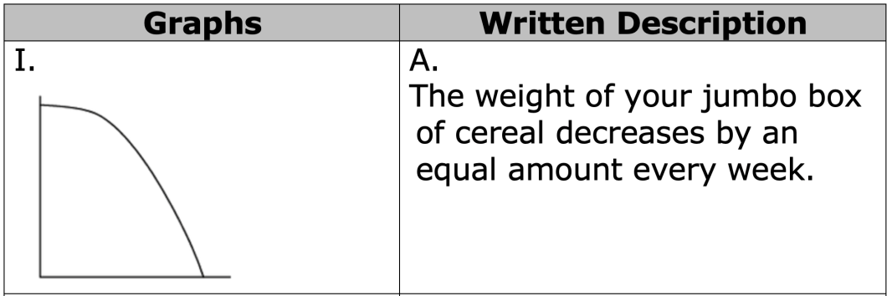
9.4.1 Warm-Up: Words, Tables, and Graphs Part 2
In the prior Warm-Up, the graphs were matched to a table of values.
Match the same graphs to the appropriate written description.
volume 2, pg. 77
Notes:
Video Link: https://algebranation.wistia.com/medias/fi4fidi5y8

Slide 7
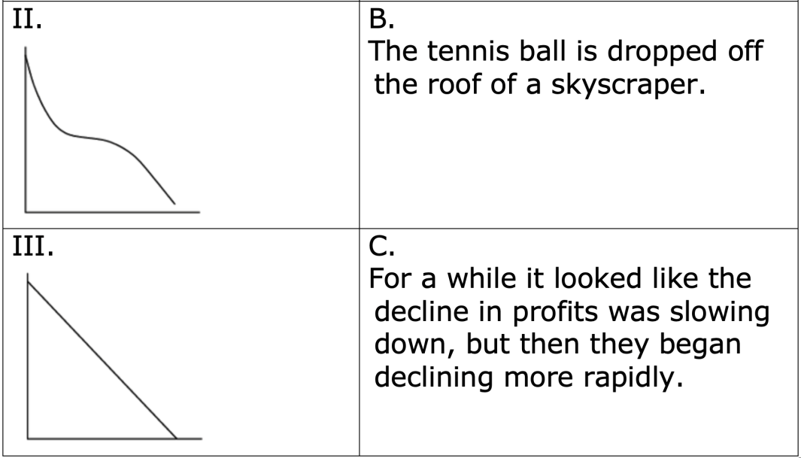
Discuss with your partner the strategy you used to match the verbal descriptions and graphs.
volume 2, pg. 77

Slide 8

Collaboration
volume 2, pg. 78

Slide 9
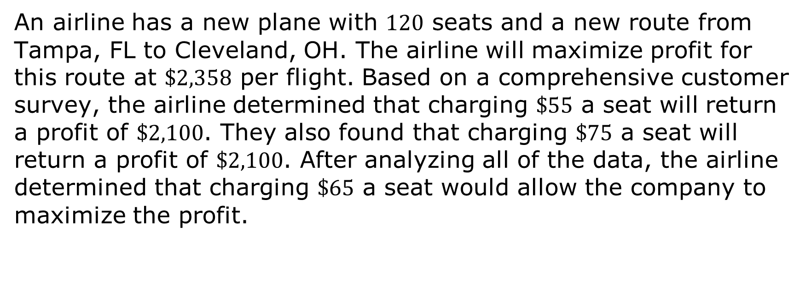
9.4.2 Collaboration: Airline Tickets
An airline has a new plane with $120$ seats and a new route from Tampa, FL to Cleveland, OH. The airline will maximize profit for this route at $\$2,358$ per flight. Based on a comprehensive customer survey, the airline determined that charging $\$55$ a seat will return a profit of $\$2,100$. They also found that charging $\$75$ a seat will return a profit of $\$2,100$. After analyzing all of the data, the airline determined that charging $\$65$ a seat would allow the company to maximize the profit.
volume 2, pg. 78

Slide 10
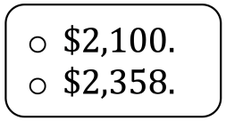
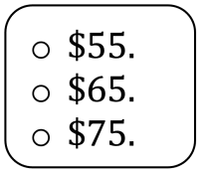
Complete the statements.
The maximum profit for the route is The seat charge for customers when the airline has achieved the maximum profit is
volume 2, pg. 78

Slide 11
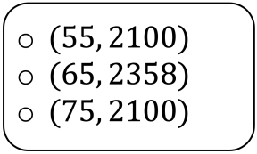
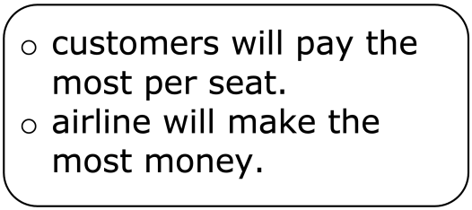
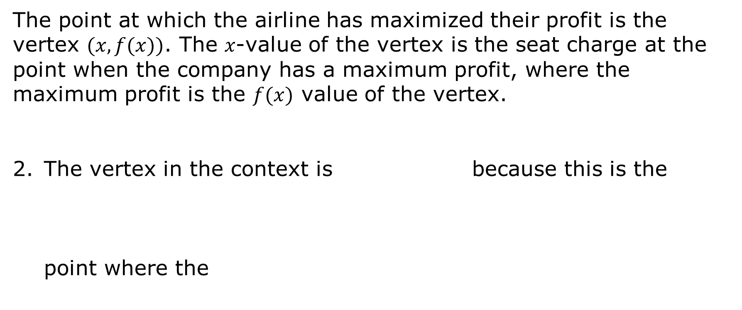
The point at which the airline has maximized their profit is the vertex $(x, f(x))$. The 𝑥-value of the vertex is the seat charge at the point when the company has a maximum profit, where the maximum profit is the $f(x)$ value of the vertex.
The vertex in the context is because this is the point where the
volume 2, pg. 78

Slide 12
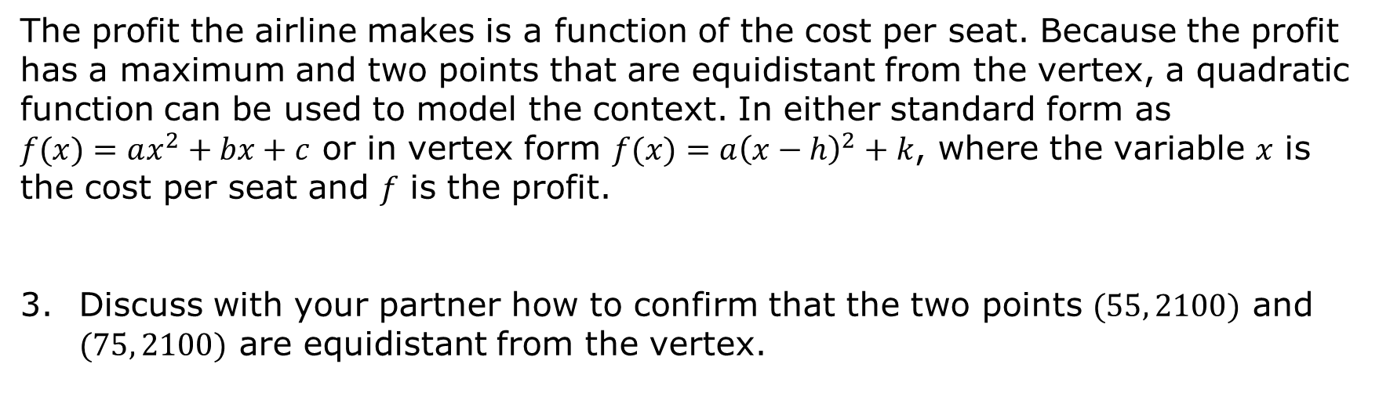
The profit the airline makes is a function of the cost per seat. Because the profit has a maximum and two points that are equidistant from the vertex, a quadratic function can be used to model the context. In either standard form as $f(x)=ax^{2}+bx+c$ or in vertex form $f(x)=a{\left(x−h\right)}^{2}+k$, where the variable 𝑥 is the cost per seat and 𝑓 is the profit.
Discuss with your partner how to confirm that the two points $(55, 2100)$ and $(75, 2100)$ are equidistant from the vertex.
volume 2, pg. 78

Slide 13
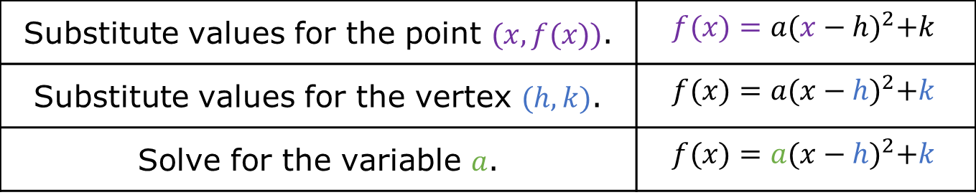
Use the steps in the table to write the quadratic function that models the airline’s profit.
Write the equation for the quadratic function in vertex form.
Substitute values for the point $(x,f(x))$. | $$f(x)=a{(x−h)}^{2}+k$$
Substitute values for the vertex $(h, k)$. | $$f(x)=a{(x−h)}^{2}+k$$
Solve for the variable $a$. | $$f(x)=a{(x−h)}^{2}+k$$
volume 2, pg. 78

Slide 14

Try It
volume 2, pg. 79

Slide 15
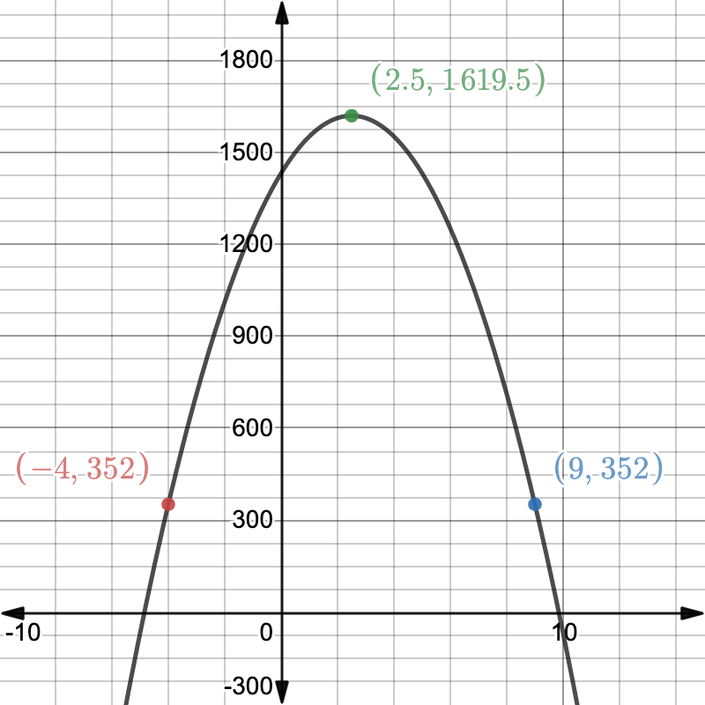
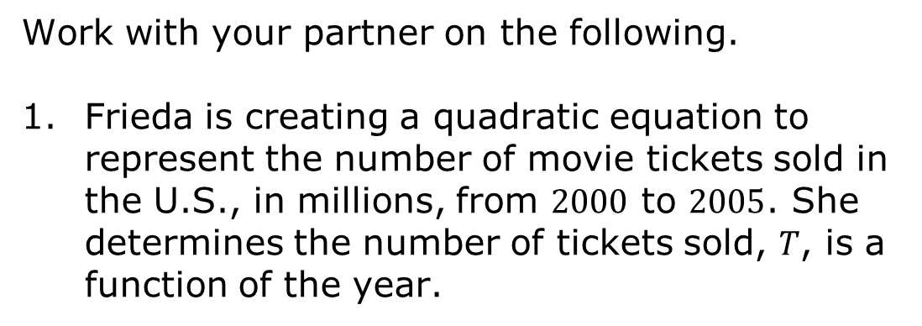
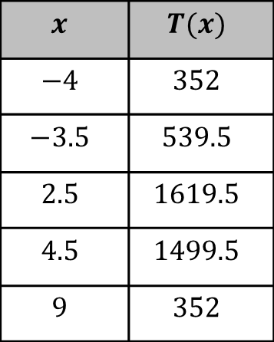
9.4.3 Try It: Writing Quadratic Functions
Work with your partner on the following.
Frieda is creating a quadratic equation to represent the number of movie tickets sold in the U.S., in millions, from $2000$ to $2005$. She determines the number of tickets sold, 𝑇, is a function of the year.
$$x$$ | $$T(x)$$
$$−4$$ | $$352$$
$$−3.5$$ | $$539.5$$
$$2.5$$ | $$1619.5$$
$$4.5$$ | $$1499.5$$
$$9$$ | $$352$$
volume 2, pg. 79

Slide 16
Write the quadratic function in both vertex and standard form that models the context. Show your work. Then, write the equations in the table in problem 3.
volume 2, pg. 79

Slide 17
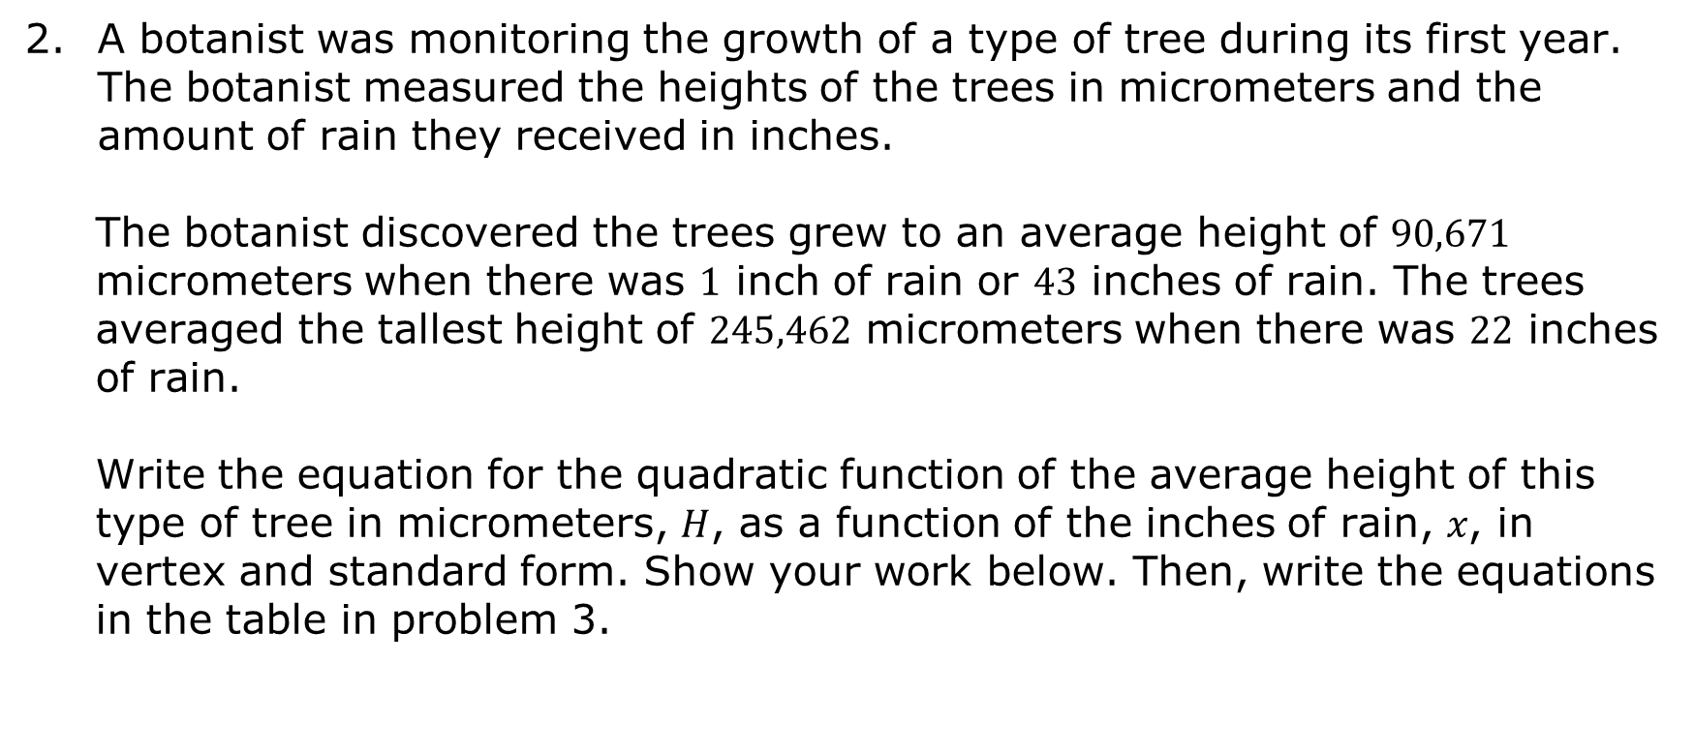
A botanist was monitoring the growth of a type of tree during its first year. The botanist measured the heights of the trees in micrometers and the amount of rain they received in inches.
The botanist discovered the trees grew to an average height of $90,671$ micrometers when there was $1$ inch of rain or $43$ inches of rain. The trees averaged the tallest height of $245,462$ micrometers when there was $22$ inches of rain.
Write the equation for the quadratic function of the average height of this type of tree in micrometers, 𝐻, as a function of the inches of rain, 𝑥, in vertex and standard form. Show your work below. Then, write the equations in the table in problem 3.
volume 2, pg. 79

Slide 18
Ask another pair of students to check your work for the two quadratic equations you wrote for each context, while you and your partner check their work. If necessary, correct any errors. Each person should write their initials next to your equations stating that your equations are correct or were corrected after fixing any errors.
Context | Vertex Form | Standard Form | Initials
Movie Tickets
Tree Height
volume 2, pg. 79

Slide 19

Your Turn
volume 2, pg. 80

Slide 20

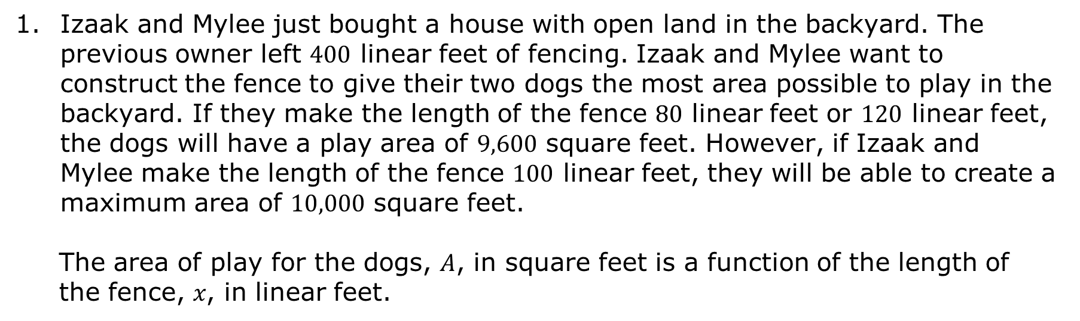
9.4.4 Your Turn!
Izaak and Mylee just bought a house with open land in the backyard. The previous owner left $400$ linear feet of fencing. Izaak and Mylee want to construct the fence to give their two dogs the most area possible to play in the backyard. If they make the length of the fence $80$ linear feet or $120$ linear feet, the dogs will have a play area of $9,600$ square feet. However, if Izaak and Mylee make the length of the fence $100$ linear feet, they will be able to create a maximum area of $10,000$ square feet.
The area of play for the dogs, 𝐴, in square feet is a function of the length of the fence, 𝑥, in linear feet.
volume 2, pg. 80

Slide 21
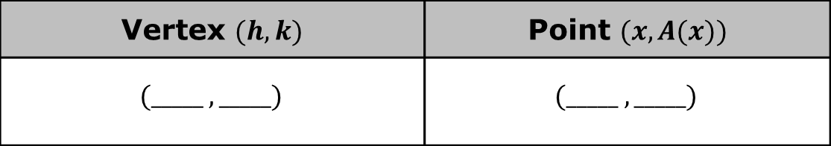
What is the point (𝑥, 𝑦) where the dogs will have the maximum fenced in area?
Identify one other point from the context.
Vertex $(h, k)$ | Point $(x,A(x))$
$$(_____ , _____)$$ | $$(_____ , _____)$$
volume 2, pg. 80

Slide 22
Using the vertex and point, write the quadratic function in vertex form.
Vertex Form
volume 2, pg. 80

Slide 23
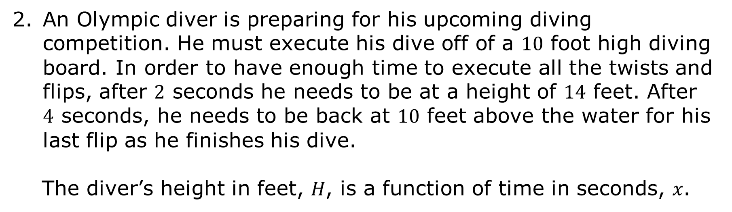
An Olympic diver is preparing for his upcoming diving competition. He must execute his dive off of a $10$ foot high diving board. In order to have enough time to execute all the twists and flips, after $2$ seconds he needs to be at a height of $14$ feet. After $4$ seconds, he needs to be back at $10$ feet above the water for his last flip as he finishes his dive.
The diver’s height in feet, 𝐻, is a function of time in seconds, 𝑥.
volume 2, pg. 80

Slide 24
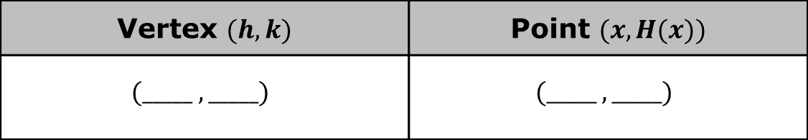
Identify the vertex and one additional point of the function from the context.
Write the quadratic function in standard form.
Vertex $(h, k)$ | Point $(x, H(x))$
$$(_____ , _____)$$ | $$(_____ , _____)$$
volume 2, pg. 80

Slide 25

Wrap-Up
volume 2, pg. 81

Slide 26
9.4.5 Wrap-Up: Cool Down
The last three lessons have involved writing quadratic functions to represent the relationship between two quantities from a graph, a table, and a written description.
Create a sales pitch to convince your classmates which representation you feel is the easiest for writing quadratic functions.
volume 2, pg. 81

